Slide 1
Digital Twins Pegatron Room Type Recommendation
黃昱叡

Slide 2
Room Type Recommendation
Each room type includes information such as the room name, price, area, features, and number of beds.
The website interface display all room information in the form of Card.
Clicking on the card will enlarge the room image.
Users can find suitable rooms through the chat assistant.
Developers can generate new room information and images through automated recommendation system.

Slide 3




AI Agent Tool
gemma3:27b-it-qat
AI Agent
rooms.json

Slide 4
GitHub Copilot
An AI-powered coding assistant developed by GitHub and OpenAI.
Features
1. Real-time code completion
2. Code snippet generation
3. Supports multiple programming languages
4. Adapts to your coding style
Platform
1. Visual Studio / Visual Studio Code
2. JetBrains IDE (Intellij IDEA、PyCharm)
Notes:
即時程式碼補全：在撰寫程式碼時提供即時建議。
自動生成函式或程式片段：根據註解或函式名稱自動產生程式碼。
支援多種語言：如 JavaScript、Python、TypeScript、Go、Ruby、C++ 等。
編碼風格學習：會根據使用者專案中的風格提供更合適的建議。

Slide 5
Ollama
Ollama is a developer-friendly platform that enables you to run large language models (LLMs) locally.
Features
1. Offline prototyping and development
2. GPU acceleration supported (especially for M-series Macs and NVIDIA GPUs).
3. Supports many open-source models like LLaMA 3, Mistral, Gemma, and more.
Notes:
Ollama 是一個專為開發者設計的平台，能讓你在本地端執行大型語言模型（LLMs）。
離線開發原型與測試
支援多種開源模型：如 LLaMA 2、LLaMA 3、Mistral、Gemma 等。
支援 GPU 加速（特別適用於 Apple M 系列晶片或 NVIDIA 顯卡）。

Slide 6
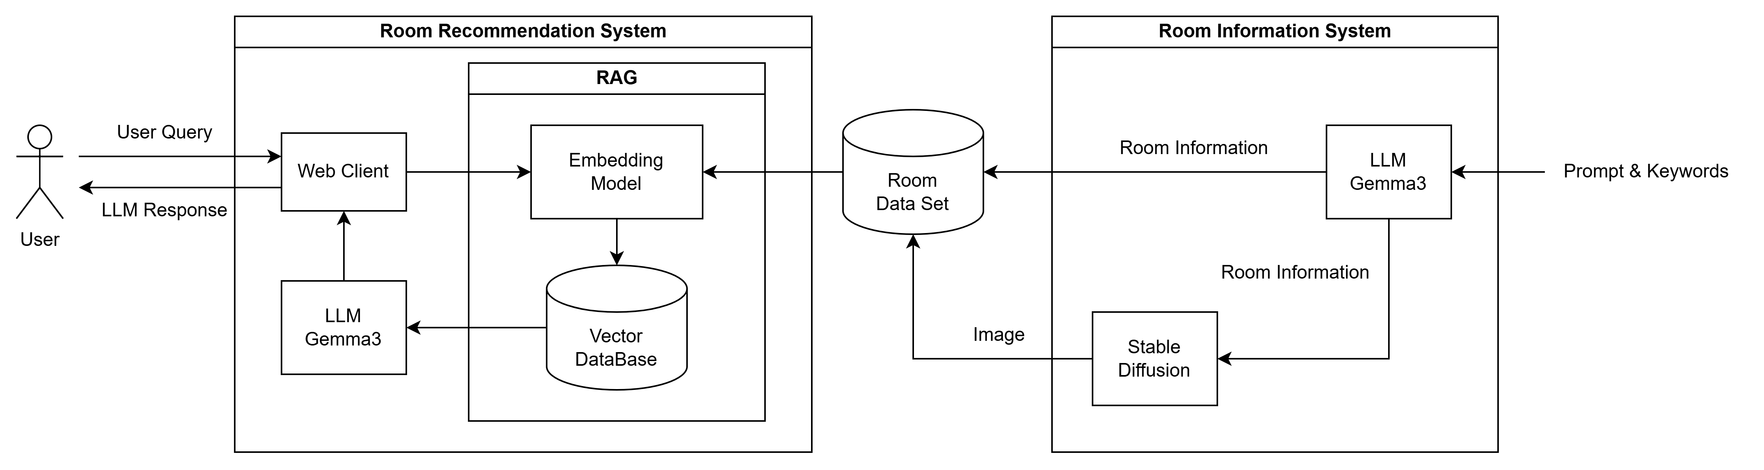
System Structure

Slide 7
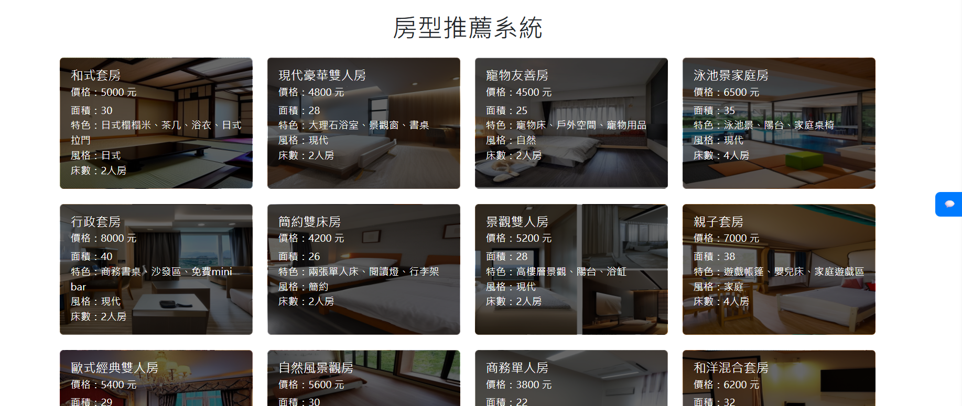
Web Interface

Slide 8
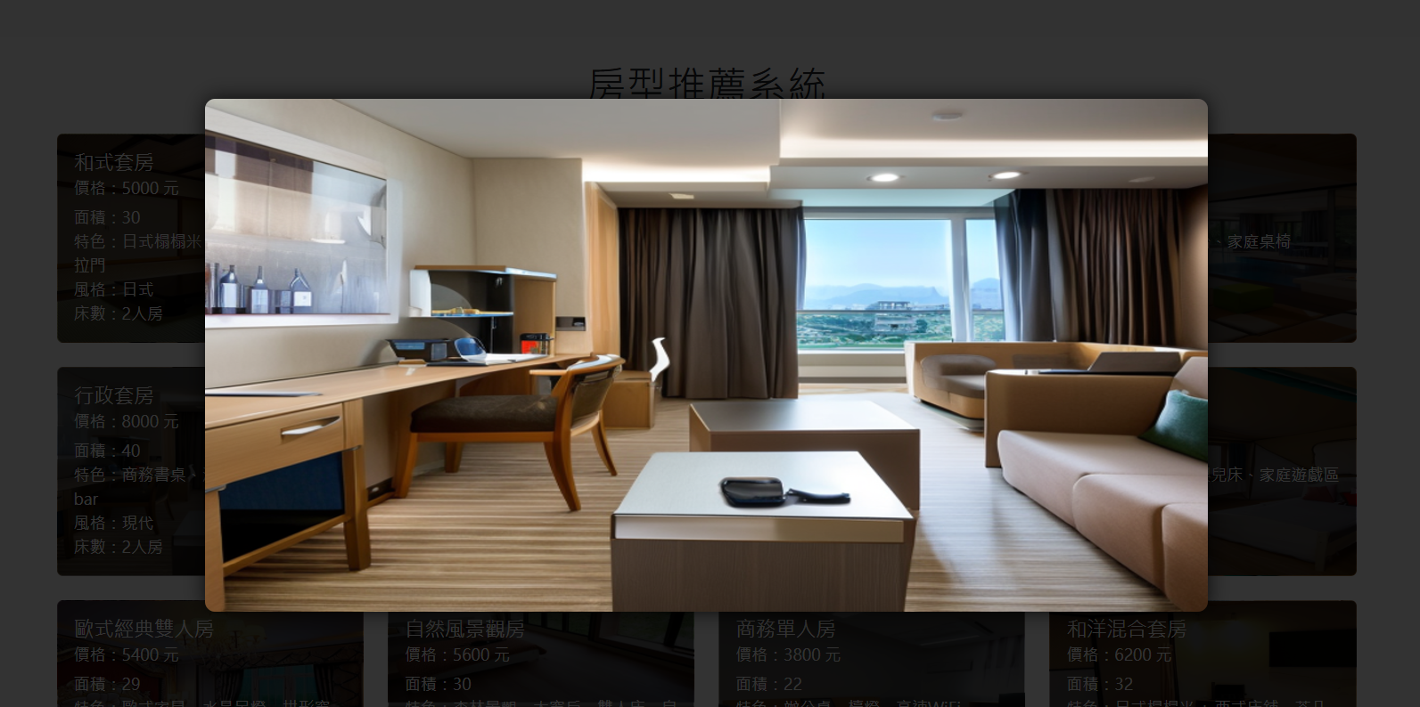
Web Interface

Slide 9
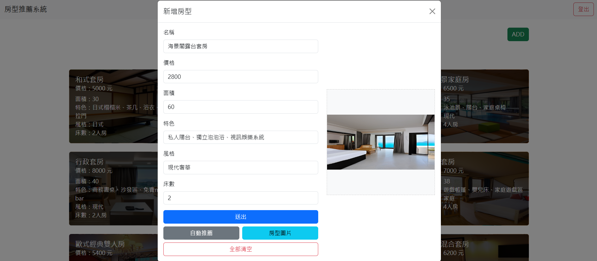
Auto Recommend

Slide 10
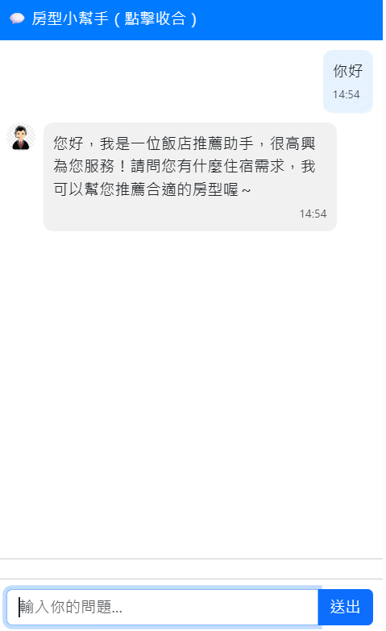
AI Chat Bot

Slide 11
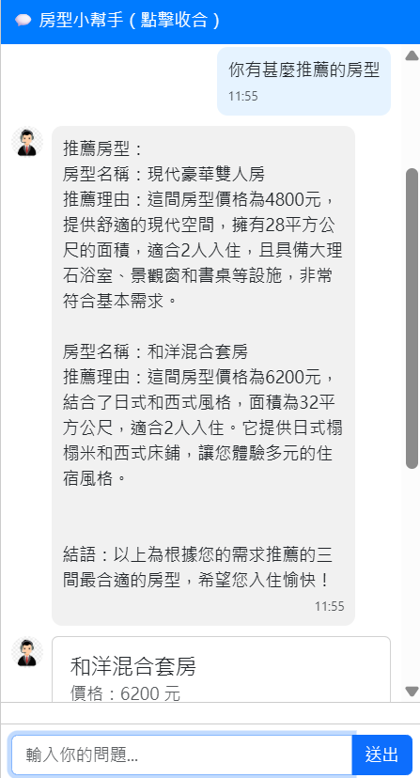
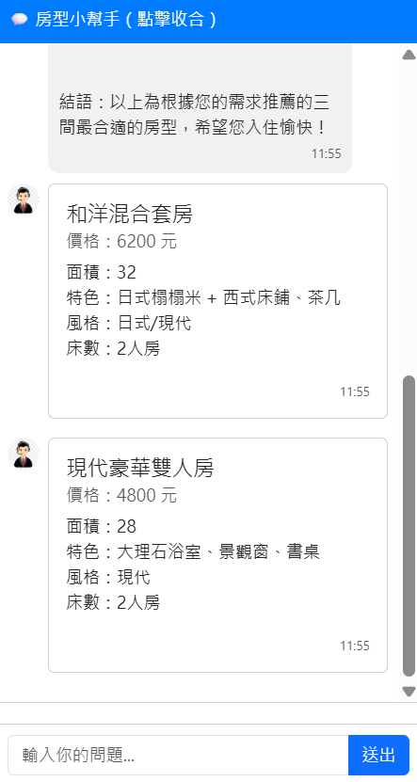
Normal Recommendation
✔
✔

Slide 12
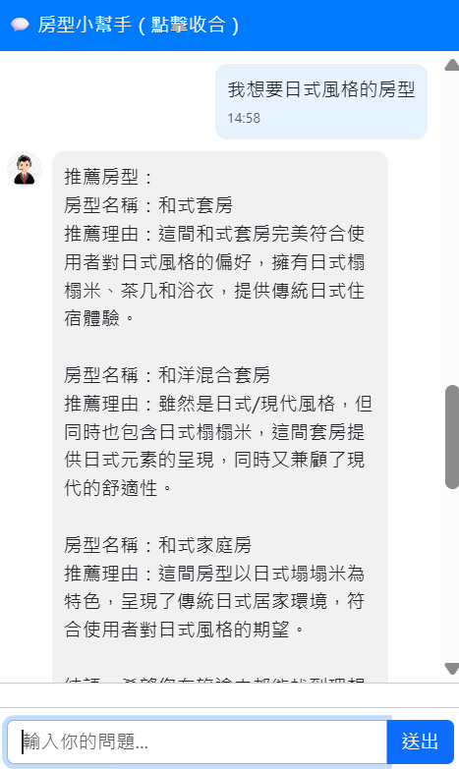
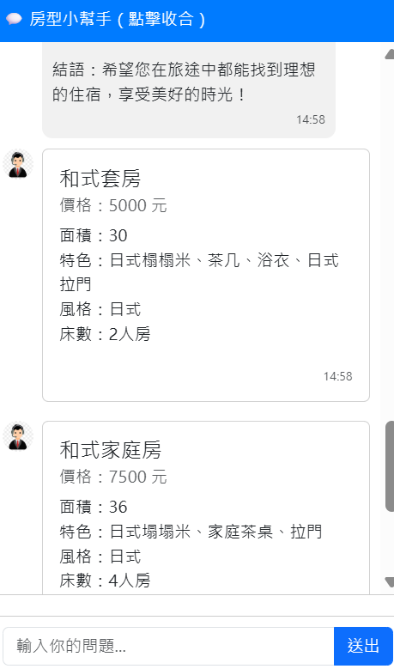
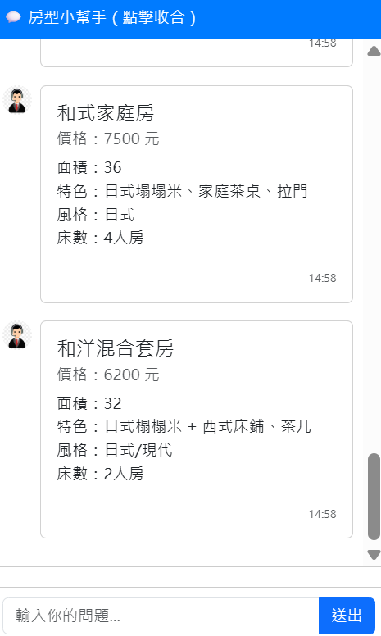
Style Recommendation
✔
✔
✔

Slide 13
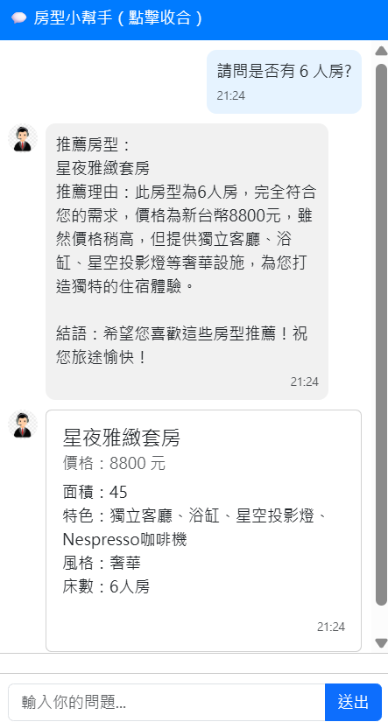
Bad Recommendation
✔

Slide 14
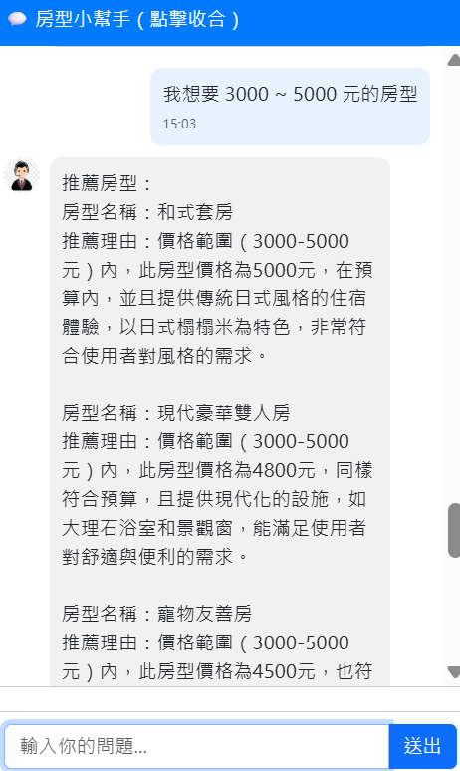
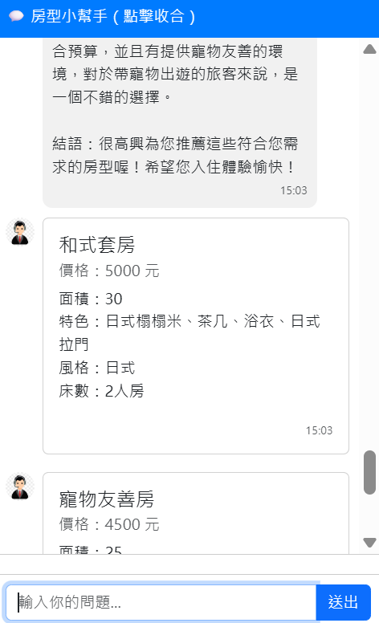
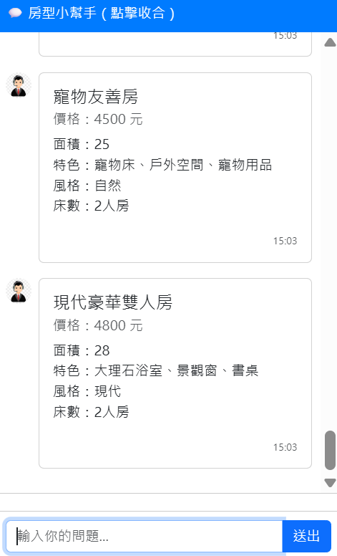
Price Recommendation
✔
✔
✔

Slide 15
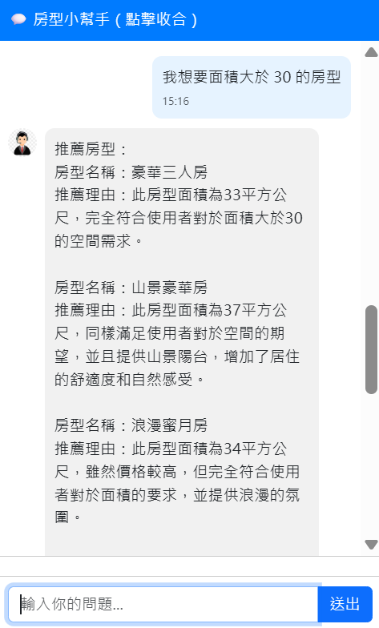
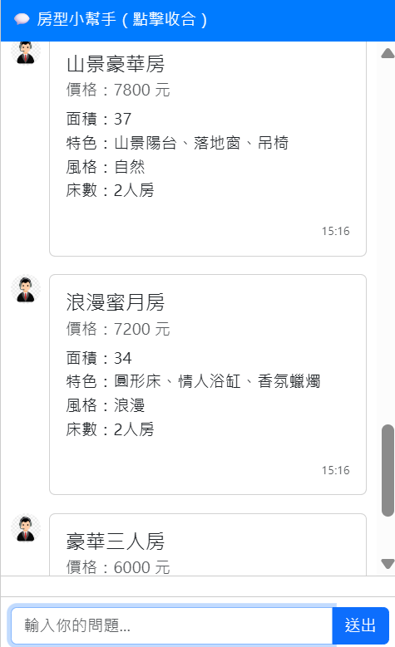
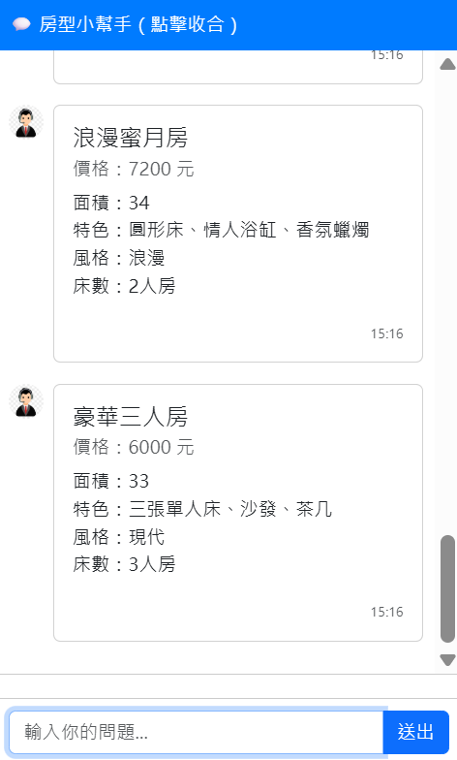
Area Recommendation
✔
✔
✔

Slide 16
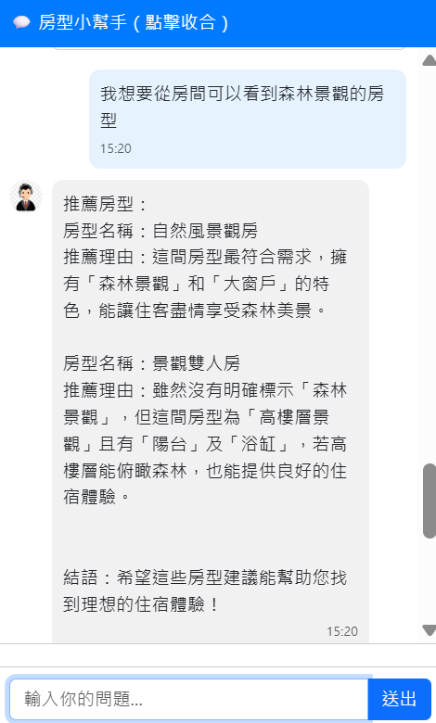
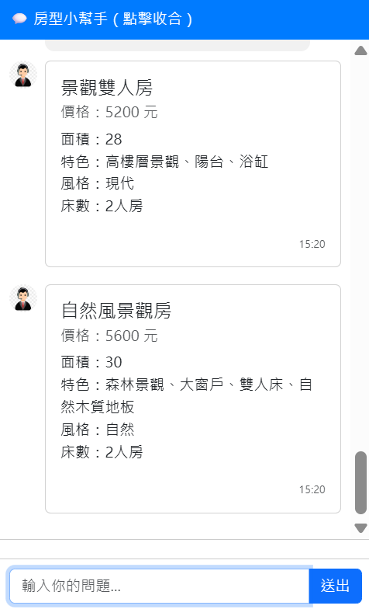
Feature Recommendation
✔
✔

Slide 17
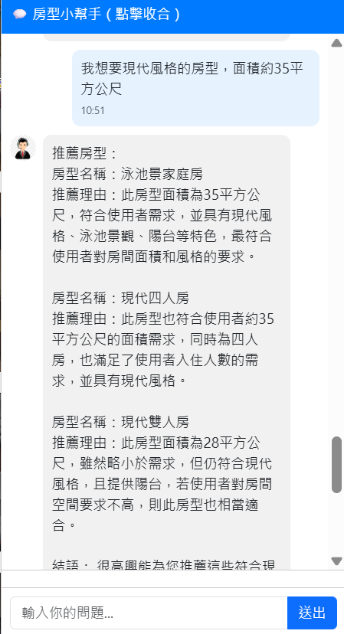
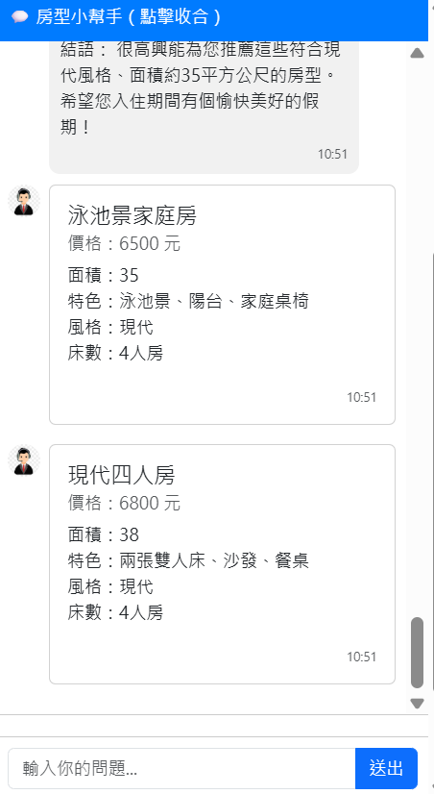
Multiple Conditions Recommendation
✔
✔
✔
✔

Slide 18
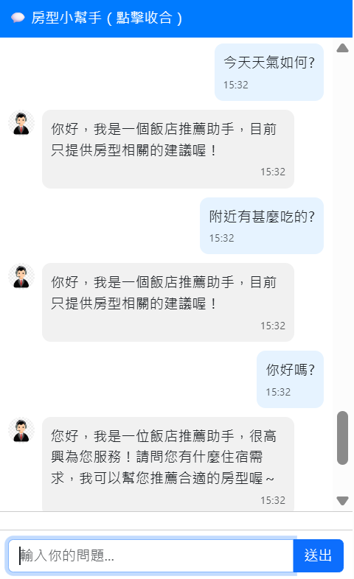
Irrelevant Question

Slide 19


Other Feature
Added a waiting prompt message to indicate that the AI ​​is thinking
Add Timestamp
Press Enter to automatically send the message
Press the ESC key to automatically close the room image

Slide 20


Coverage Report
Test Statements
Develop Time
807
9 hr
Test Cases
Code Coverage
91
100%

Slide 21
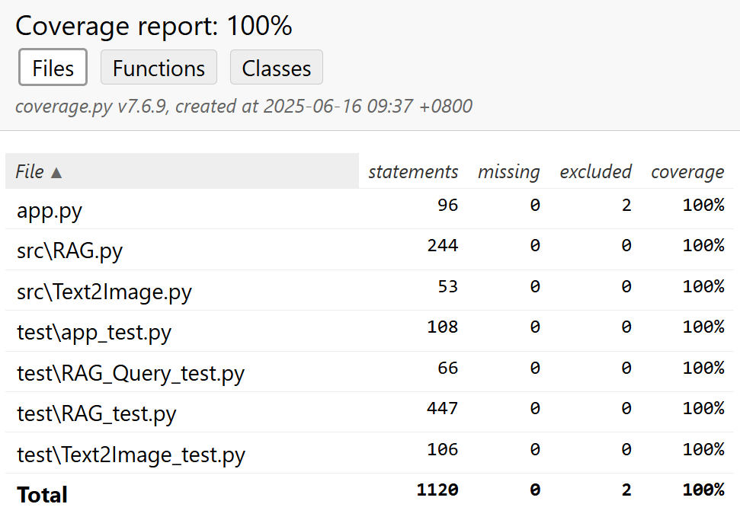
Coverage Report

Slide 22
Review
GitHub Copilot 可直接於 IDE 中快速使用
根據自然語言描述與上下文，自動補完程式碼或建議實作邏輯
提供靈感與想法
即時互動，快速回應
支援多種程式語言與框架
減少手動撰寫的時間，提升整體開發效率

Slide 23
Thank you for Listening

